Slide 1
SYSTEM DESIGN DIAGRAMS

Slide 2
USE CASE DIAGRAM
The use case diagram describes the possible interactions of the user with the system.
The primary users of this passenger positioning system are:
The Driver
The passenger

Slide 3
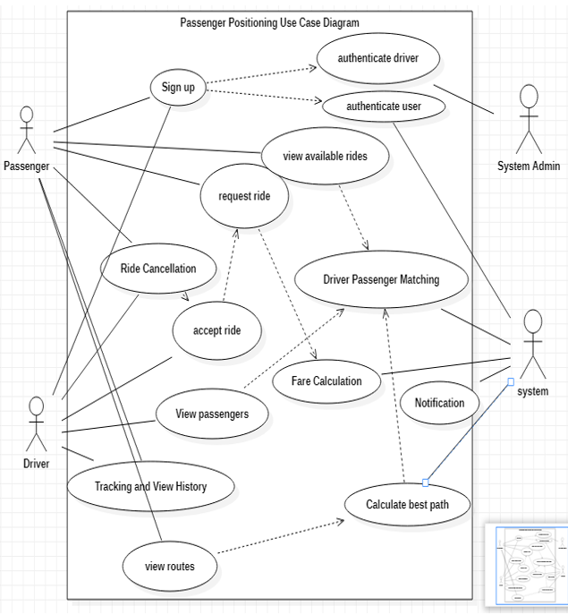
USE CASE DIAGRAM

Slide 4
Sequence diagram
These diagrams show the interaction between users of the system over time by providing visually a clear and concise way in which interactions occur.
The sequence diagrams presented here are:
Sign up
View routes
Ride request
View passenger
View history

Slide 5
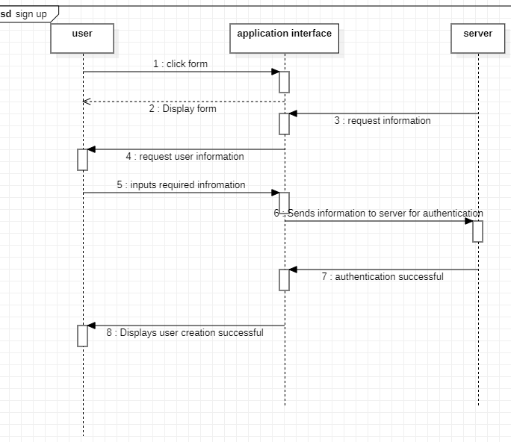
SEQUENCE DIAGRAM | SIGN UP

Slide 6
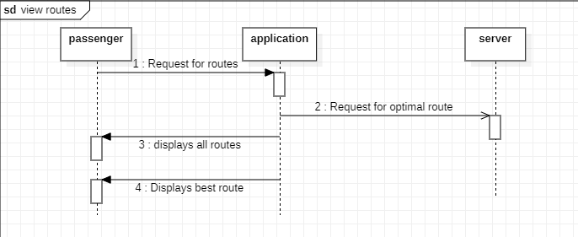
SEQUENCE DIAGRAM | VIEW ROUTES

Slide 7
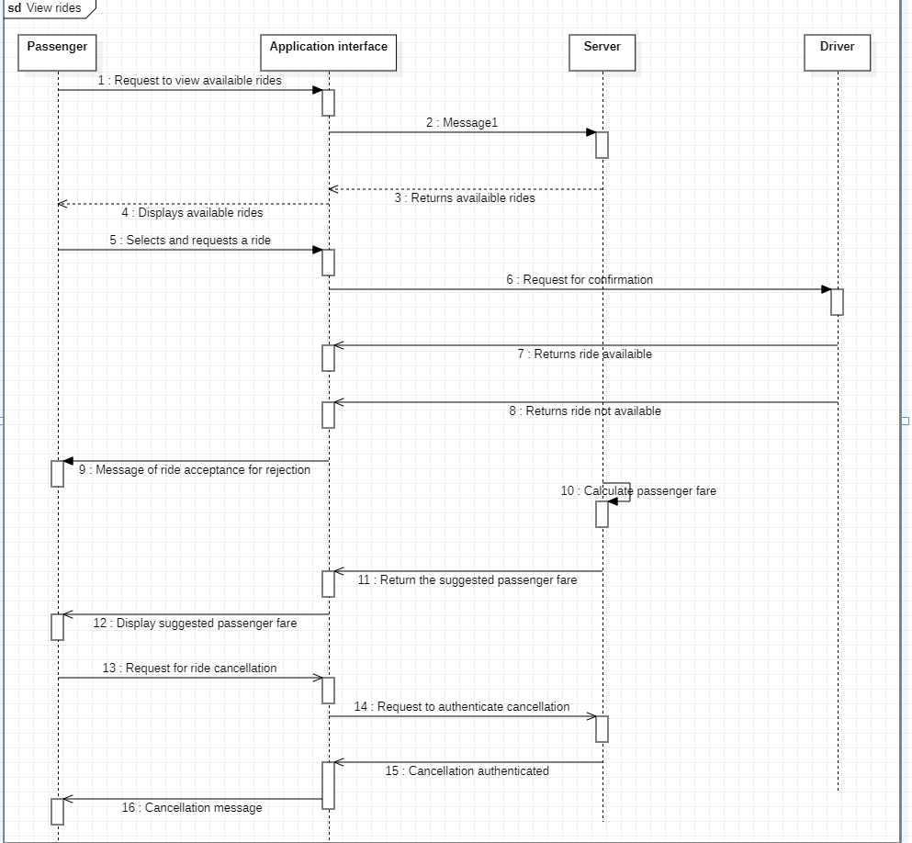
SEQUENCE DIAGRAM | RIDE REQUEST

Slide 8
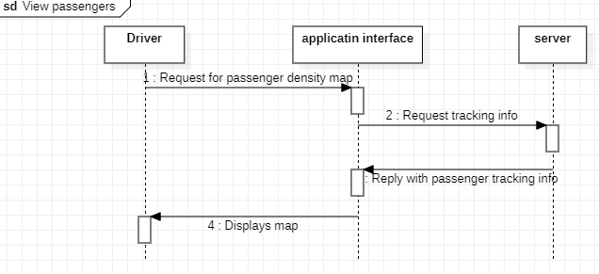
Sequence diagram | view passenger

Slide 9
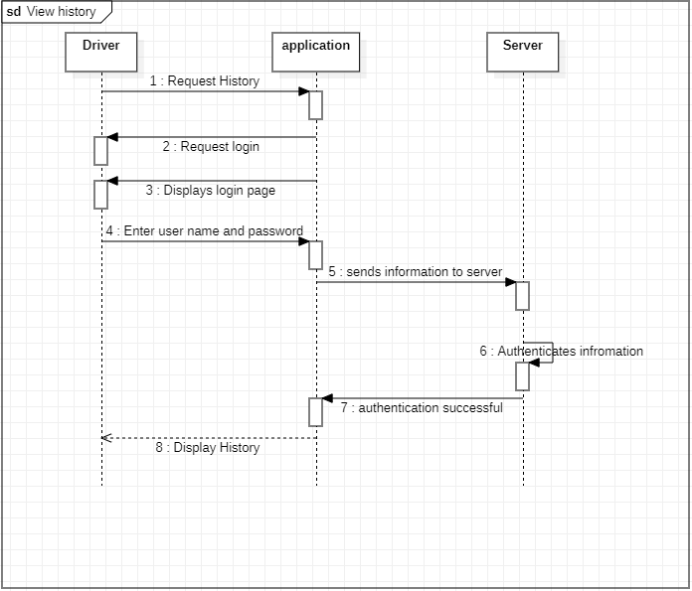
Sequence diagram | view history

Slide 10
Class diagram
This diagram provides a visual representation of the different objects in this system, their attributes, methods, and relationships with other objects.
This diagram is particularly important for ensuring that the system is well-structured, maintainable, and scalable.

Slide 11
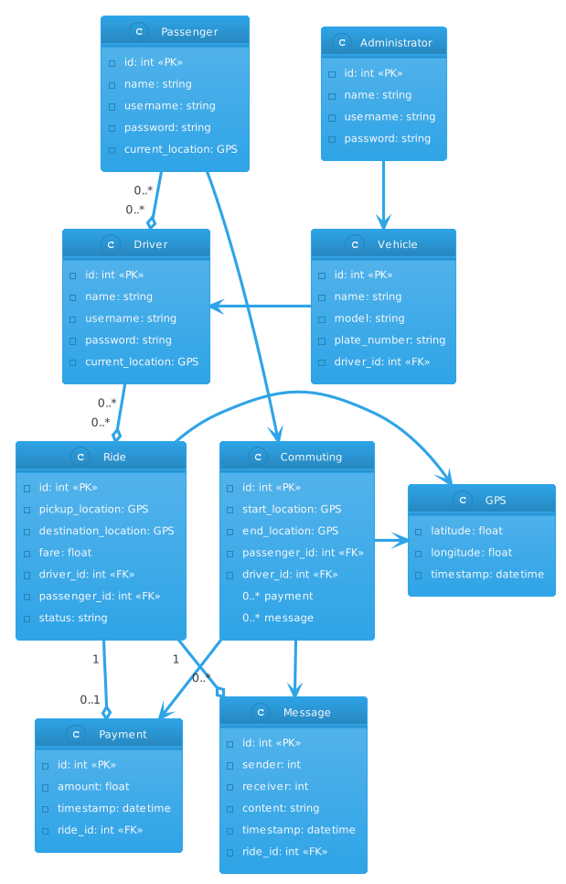
CLASS DIAGRAM

Slide 12
Data flow diagram
The Data flow diagrams (DFDs) represents the flow of data through a system or process, showing inputs, outputs, and transformations.
Their importance lies in their ability to help stakeholders understand how data moves through a system, identify potential bottlenecks or inefficiencies, and improve system design before implementation

Slide 13
Activity diagram
The activity diagram is essential tool for understanding the dynamic behaviour of the Passenger Positioning System.
It helps to visualize the different activities involved in a process and the order in which they occur.
The activity diagram ensures that the system is well-designed and meets the needs of its users.
It is also essential in communicating the dynamic behaviour of the system to other developers, stakeholders, and technical documentation.

Slide 14
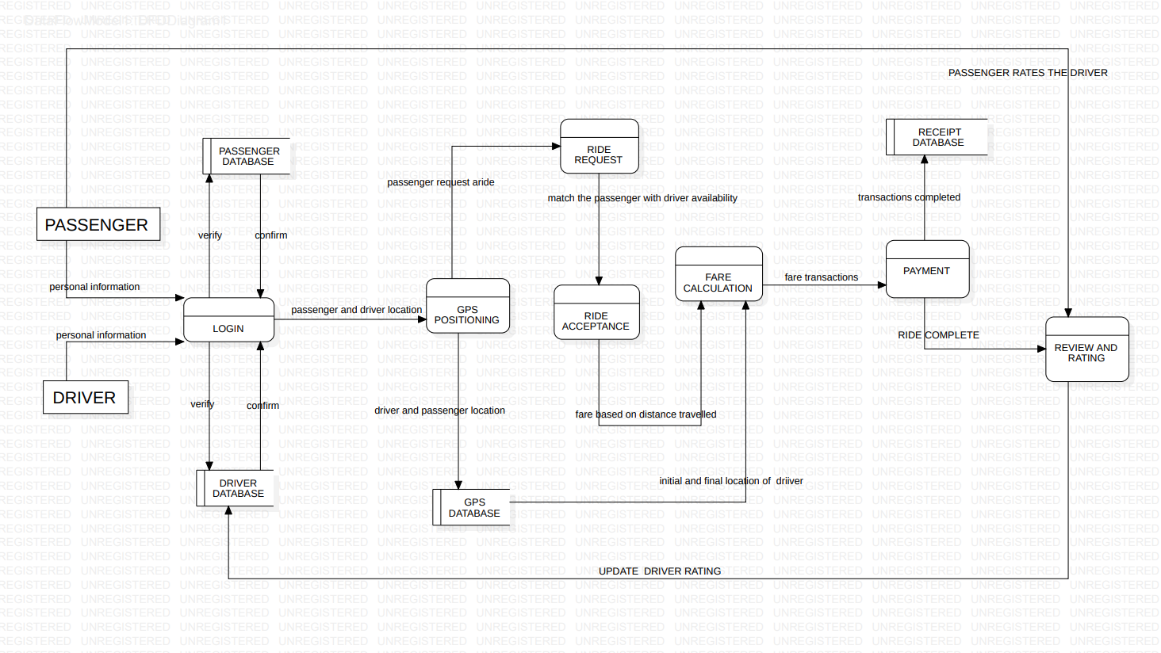
DATA FLOW DIAGRAM

Slide 15
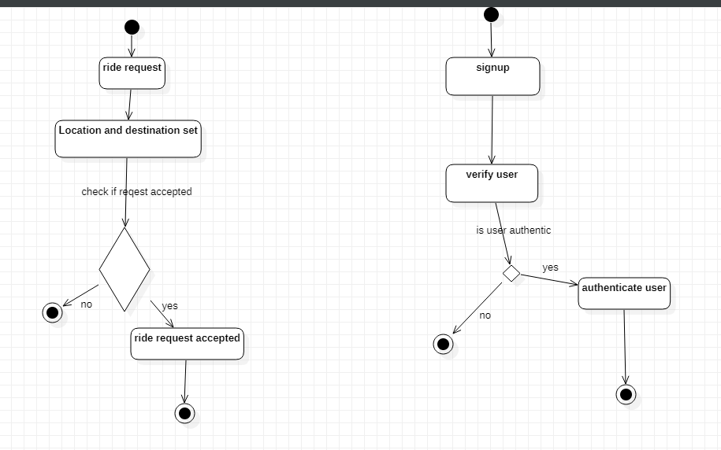
ACTIVITY DIAGRAM

